Slide 1
WORLD POPULATION ANALYSIS
POWER BI
Created by:Likitha.n

Slide 2

TOOLS USED
Power BI

Slide 3
DATA CLEANING
To clean data in Power BI, follow these steps:
Generate correct values by performing data aggregations and calculations through measures or calculated columns.
Organize data in tabular format, thereby assisting users in querying and accessing data interactively.
Remove duplicate in excel data from the raw dataset, optimizing the search and storage.
Split data fields into simple columns or merge multiple columns into a single column, enhancing the user readability
Store data as per the user-accessible formats.
Replace errors and missing values.
Resolve data quality issues.

Slide 4
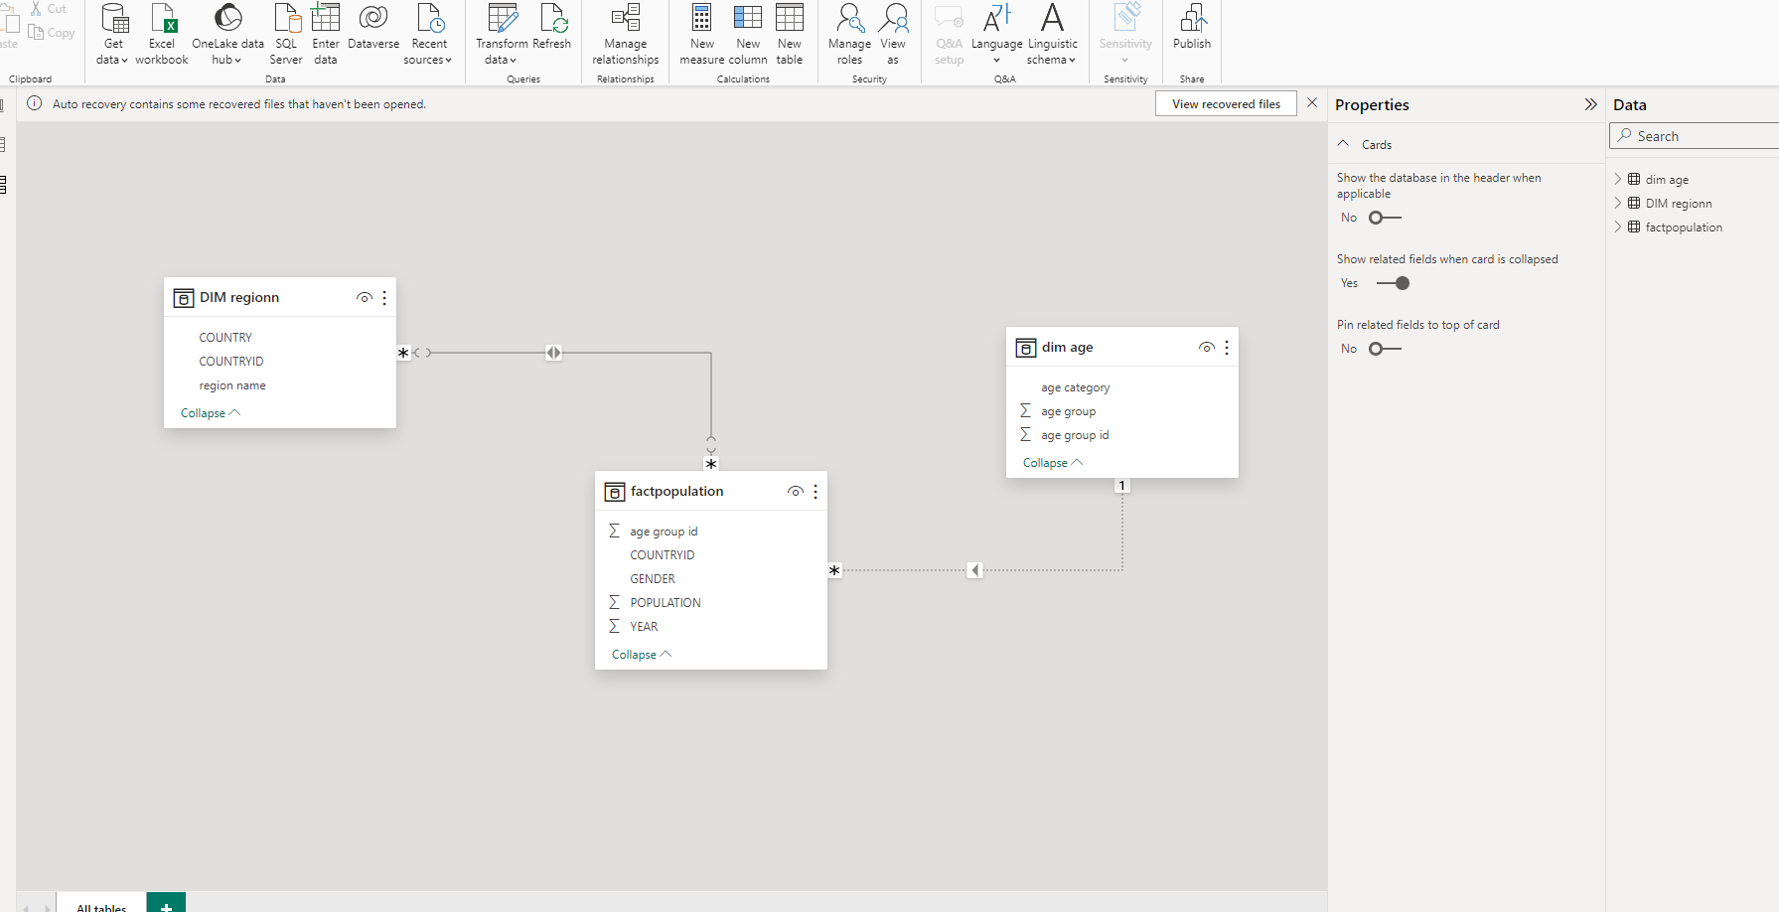
DATA MODELING
When we complete our cleaning process our next step is data modelling we need close and reload the data set into model
Create a relationship between 3 tables(using one to many relationship)
Fact population will be fact table and Dim region will be dimensional tables

Slide 5
DATA ANALYSIS
To perform data analysis using Power BI, consider the following techniques:
Explore Statistics: Start by visiting the Reports tab to create visuals and charts that represent your data effectively
Grouping in Power BI :allows merging different categories into a single group, whereas binning allows refining the size and figures used in representing the data. For data analysis in Power BI, grouping and binning plays an important role.
To create a report I have used many charts,slicers

Slide 6
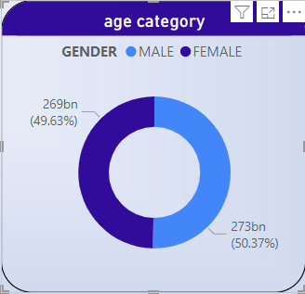
Composition of male and female population in world

Slide 7
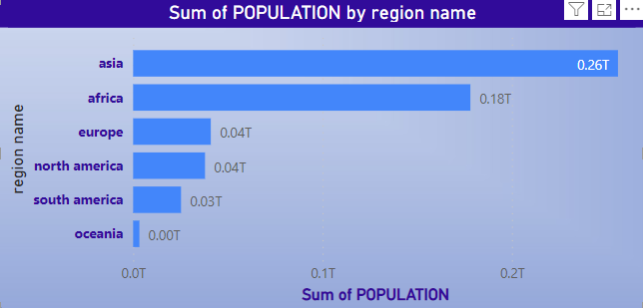
Which region is highly populated?

Slide 8
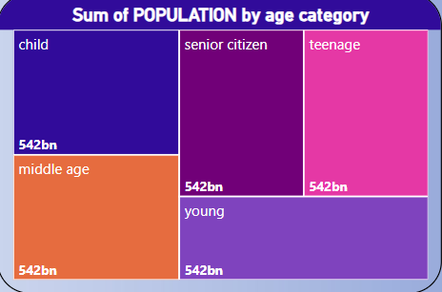
Which age group category has the highest population?

Slide 9
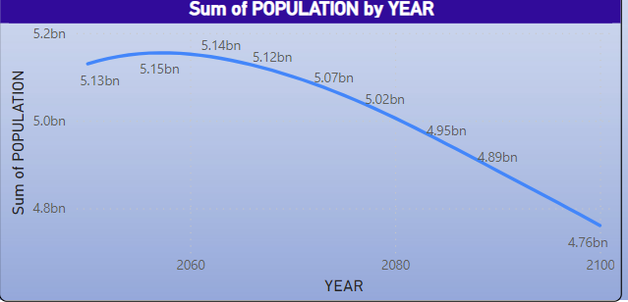
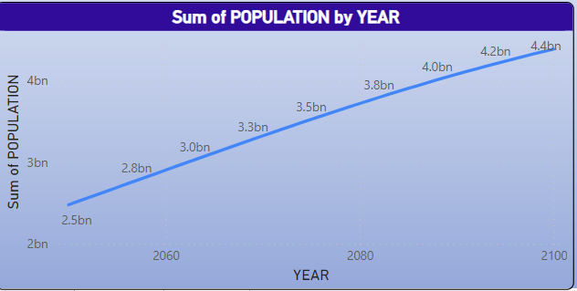
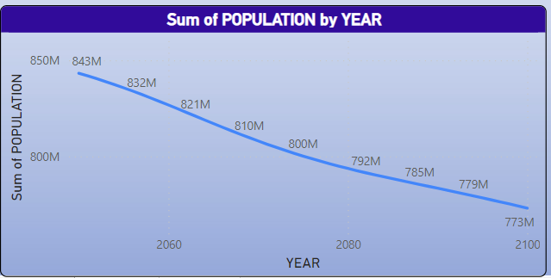
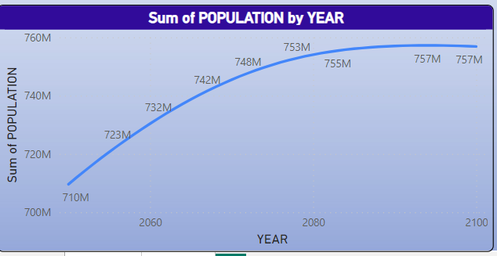
What are the population trends across all regions over the years?
asia
africa
europe
North america

Slide 10
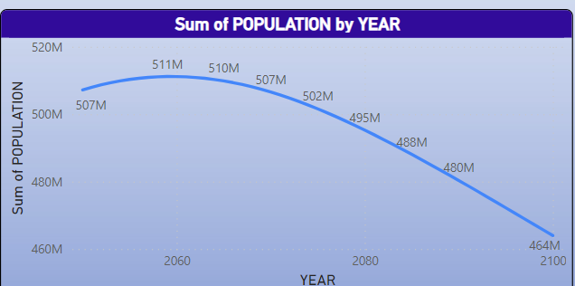
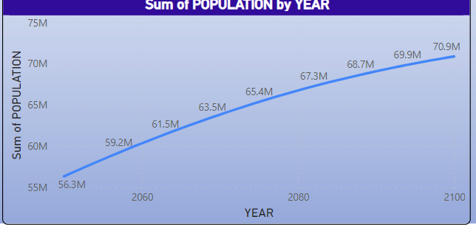
South america
oceania

Slide 11
recommendations
Reducing population growth involves multifaceted approaches, primarily focused on lowering birth rates. Key strategies include promoting family planning, ensuring access to contraception, empowering women through education and economic opportunities, and addressing societal factors that influence fertility decisions
Here's a more detailed breakdown:
1. Family Planning and Contraception
2. Addressing Social and Economic Factors
3.Addressing Environmental Factors

Slide 12
To increase population in europe
To increase Europe's population, strategies focused on boosting birth rates and encouraging immigration are commonly considered. While some countries are experiencing declining birth rates, others are seeing population increases due to immigration. Overall, the EU population is projected to decline in the coming decades, though the rate of decline may be slowed by immigration

Slide 13
thank you!

